Slide 1
Land use change
Silvia Caldararu
Email: caldaras@tcd.ie

Slide 2
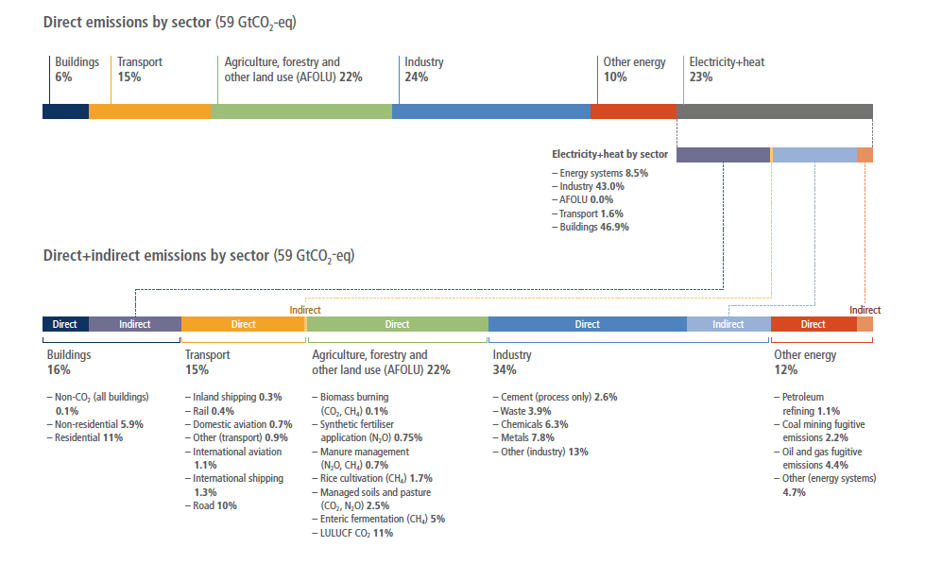

Slide 3
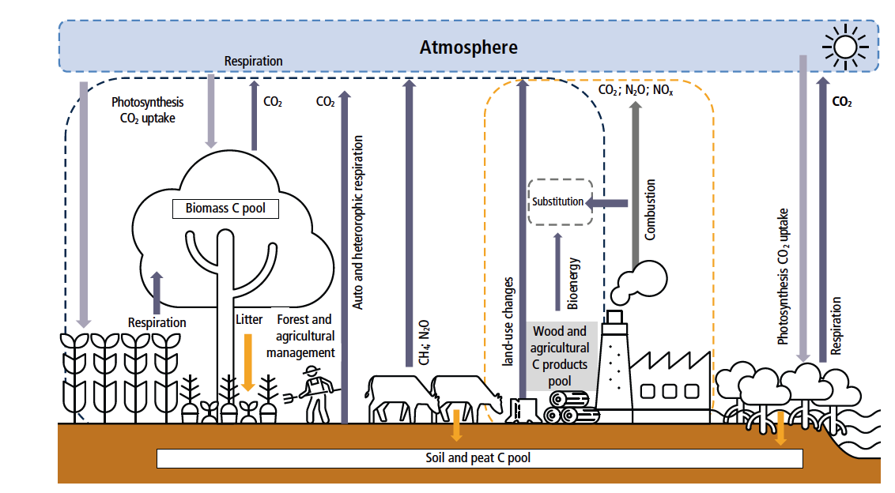
Notes:
IPCC AR6, WG III, chapter 7, figure 7.2

Slide 4
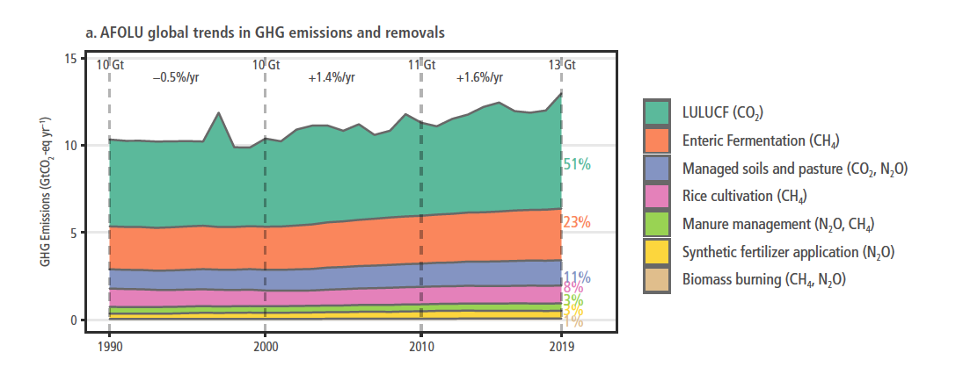
Sector contributions
Notes:
IPCC AR6, WG III, chapter 7, figure 7.3

Slide 5
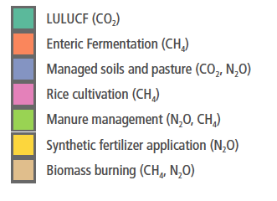
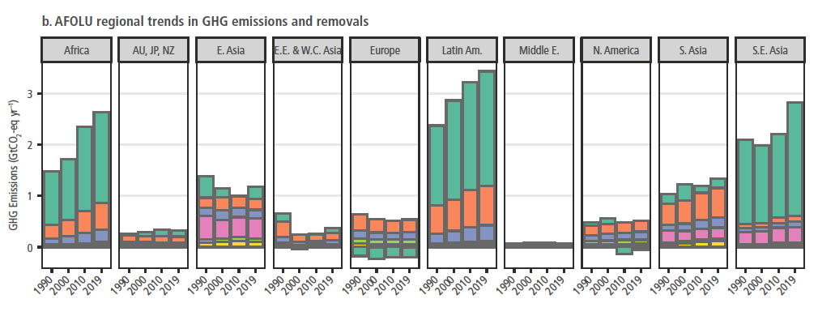
Sector contributions by region
Notes:
IPCC AR6, WG III, chapter 7, figure 7.3

Slide 6
What is land use change?
Deforestation
Conversion to managed forest
Afforestation
Urbanisation
Conversion to cropland
Conversion to rangeland

Slide 7
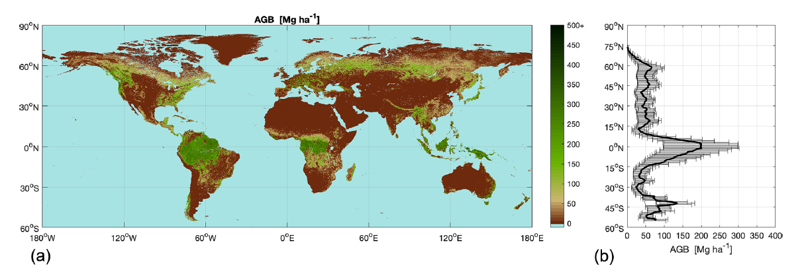
What are emissions from land use change? Vegetation C stocks
Notes:
Lecture 7

Slide 8
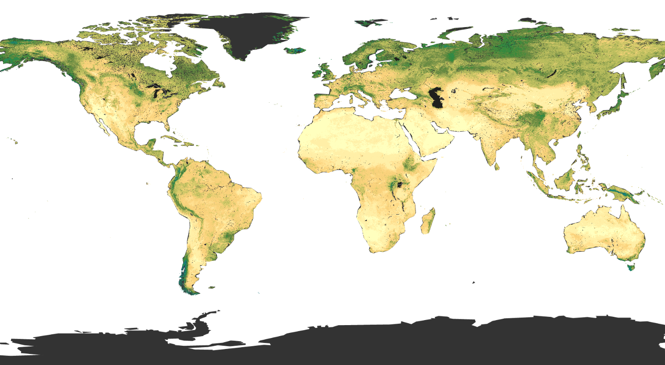
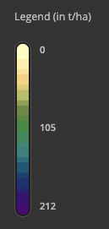
What are emissions from land use change? Soil C stocks
Notes:
Lecture 7

Slide 9
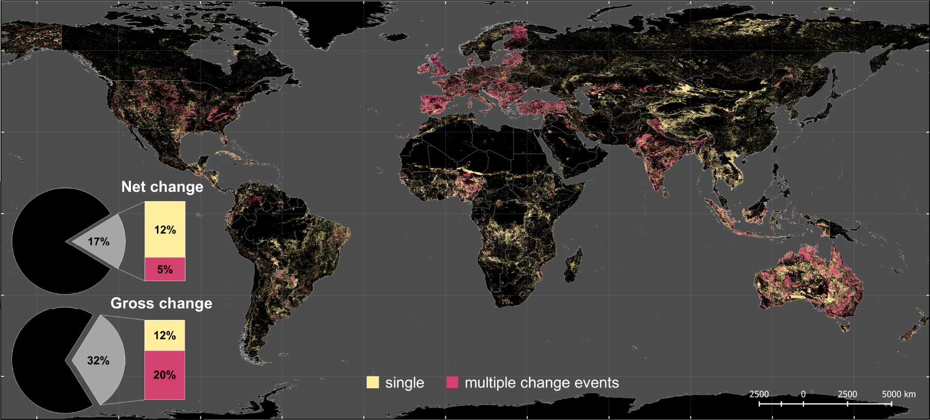
Global extent of LUC
Notes:
https://www.nature.com/articles/s41467-021-22702-2

Slide 10
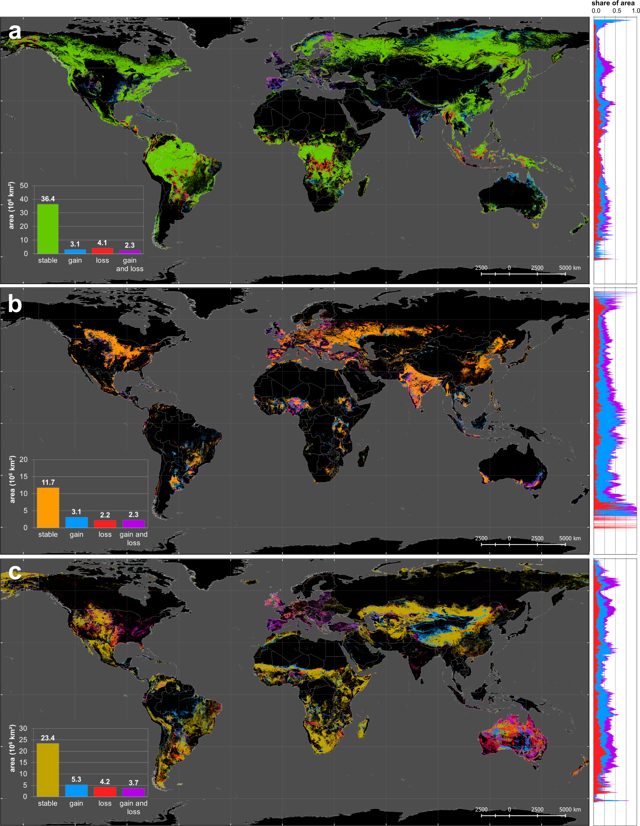
Change in forest, cropland and rangeland 1960-2019
Notes:
https://www.nature.com/articles/s41467-021-22702-2

Slide 11
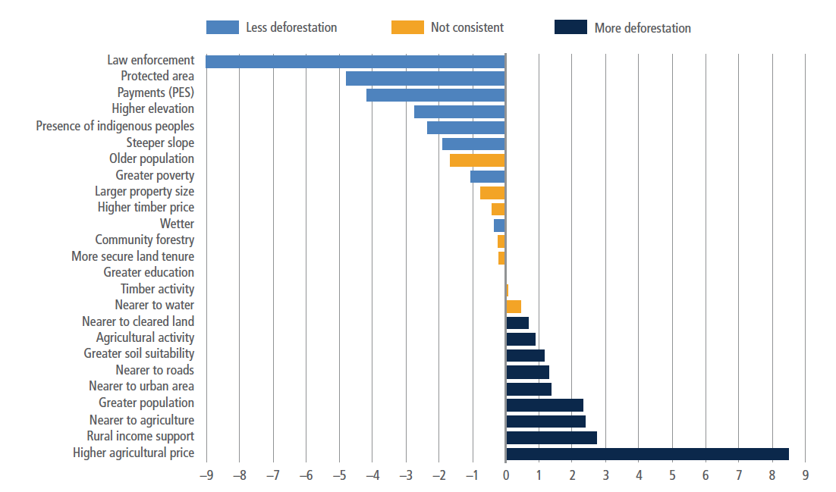
Impacts on deforestation
Notes:
IPCC AR6, WG III, chapter 7, figure 7.9

Slide 12
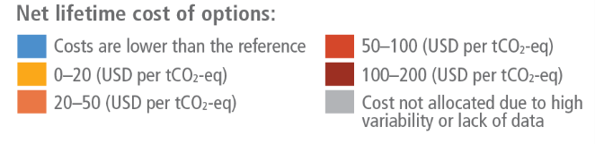
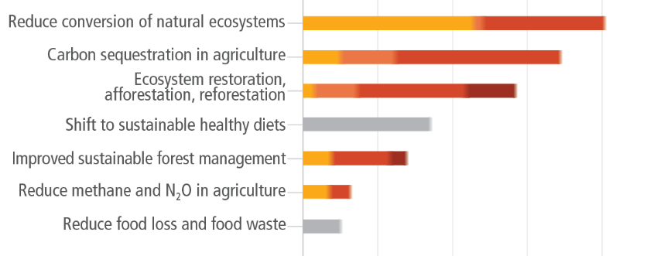
LUC mitigation
Notes:
IPCC AR6 Synthesis Report figure SPM.7

Slide 13
Reduce deforestation vs. reforestation
Young forests can have larger net C flux
Atmospheric CO₂
Pool: mass of carbon in a given Earth system component
(gC )
Flux: transfer of carbon compounds between pools
(gC /m2/day):
Photosynthesis and respiration
Old growth forests have large C stocks
Biomass

Slide 14
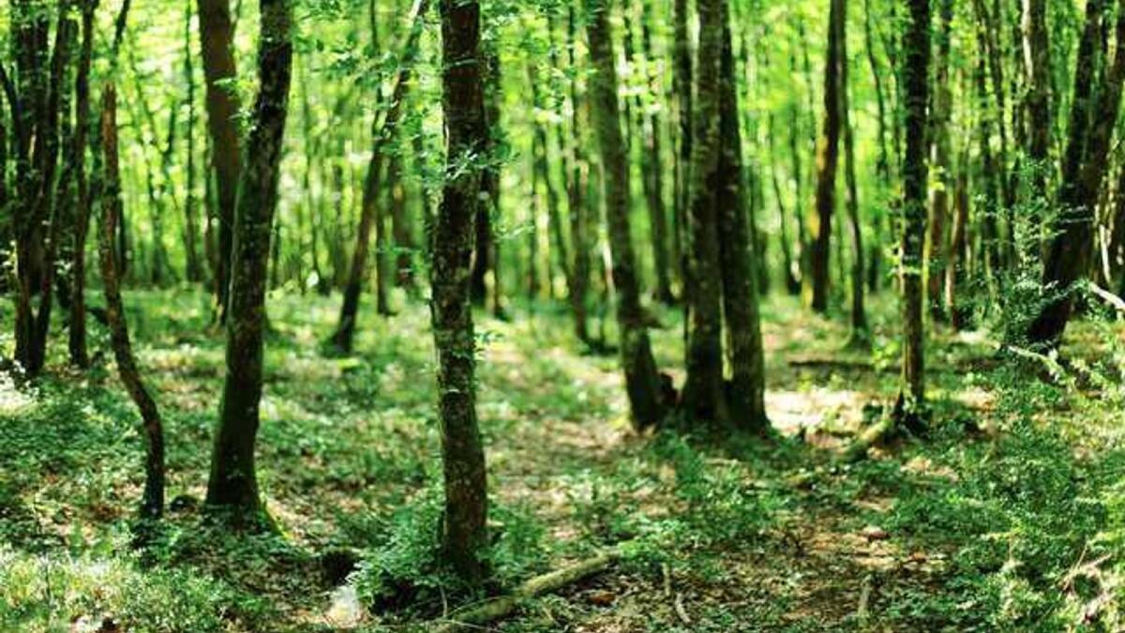
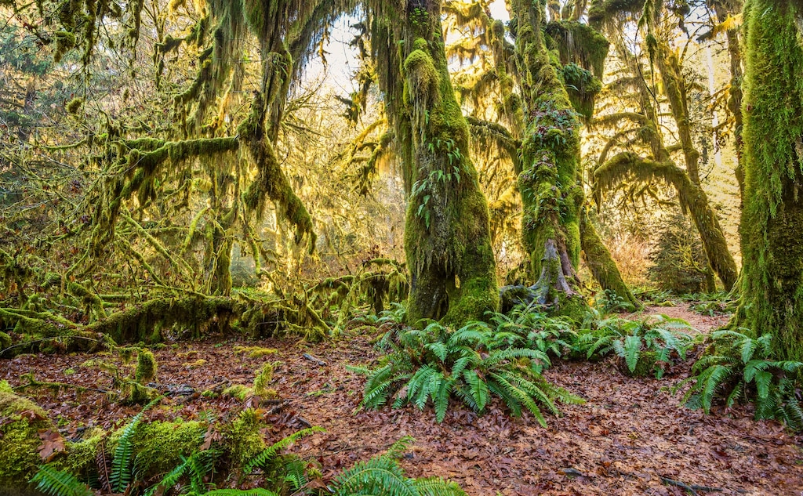
Reduce deforestation vs. reforestation
Old-growth forests are often carbon neutral, neither a sink nor a source

Slide 15
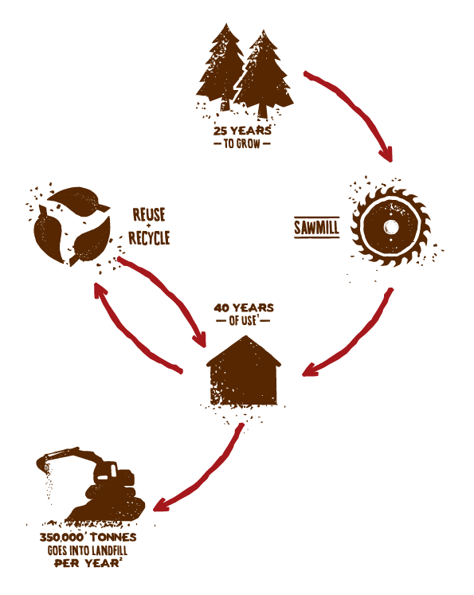

Fate of carbon from deforested ecosystem
Where does the carbon go and how long does it stay there?
What about soil carbon?

Slide 16
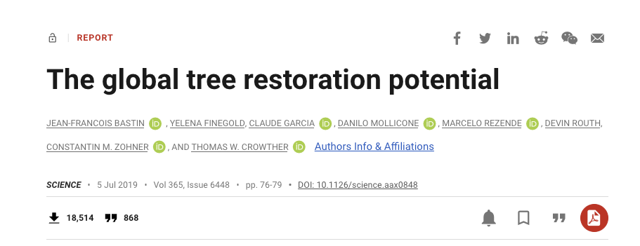
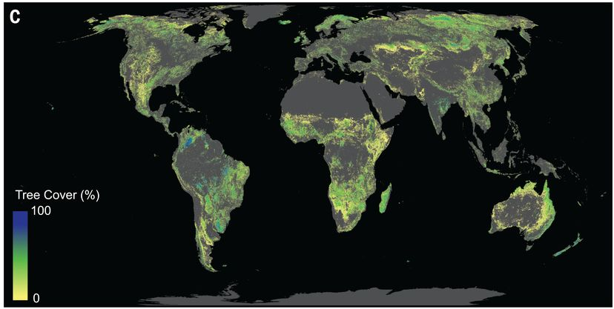

Slide 17
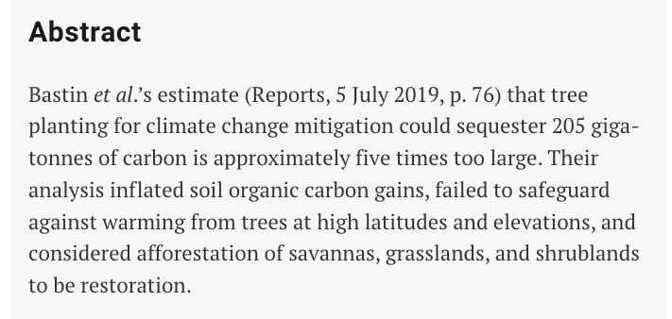
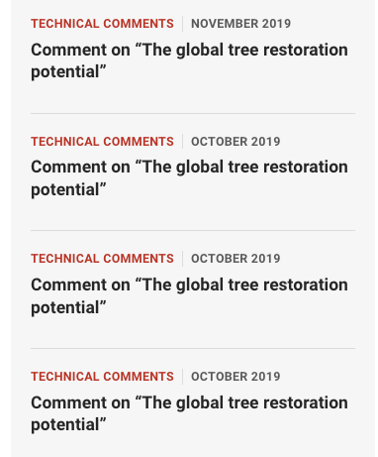
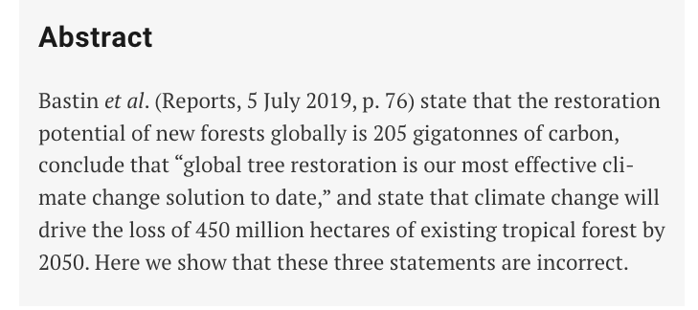

Slide 18
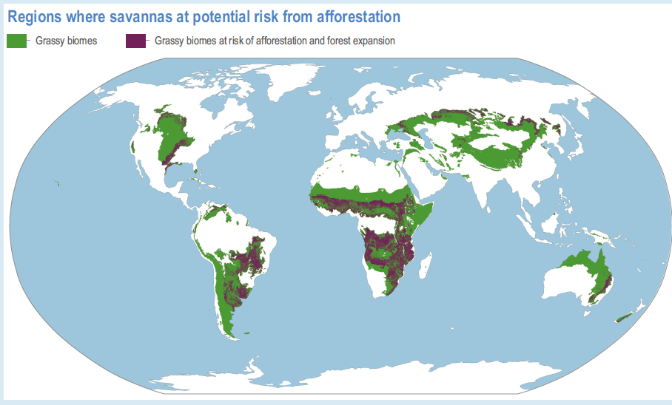
Notes:
IPCC AR6 WG II, figure box 2.2.1

Slide 19
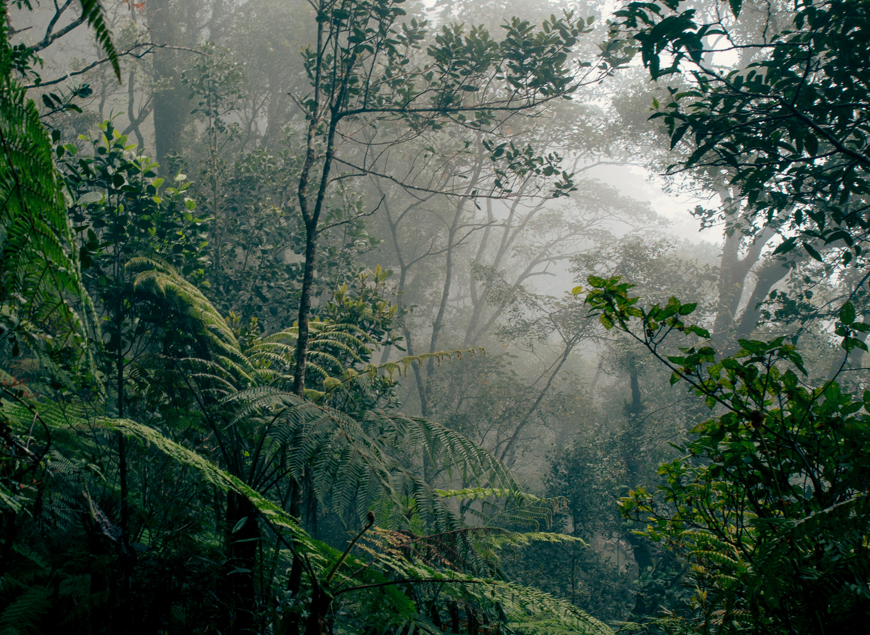
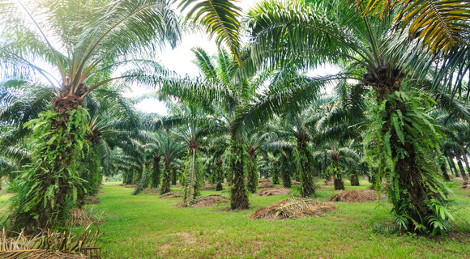
Forest to forest conversion
Natural rainforest
Oil palm plantation

Slide 20
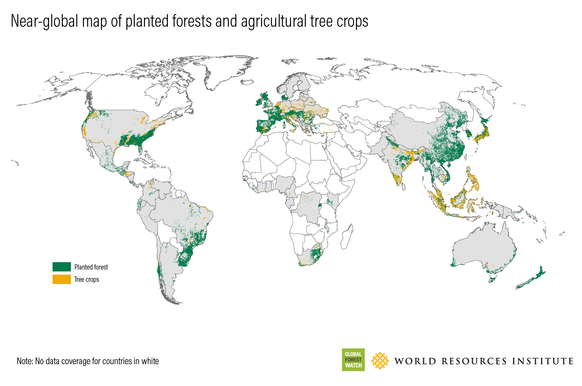
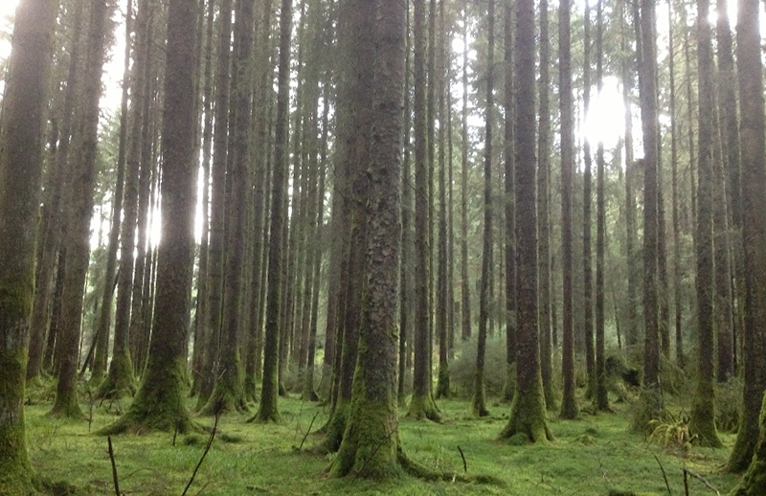
Forestry
Plantation forests managed for timber
More C stored than cropland
Biodiversity issues

Slide 21
Not everything is forest!
Notes:
IPCC AR6 Synthesis Report figure SPM.7

Slide 22
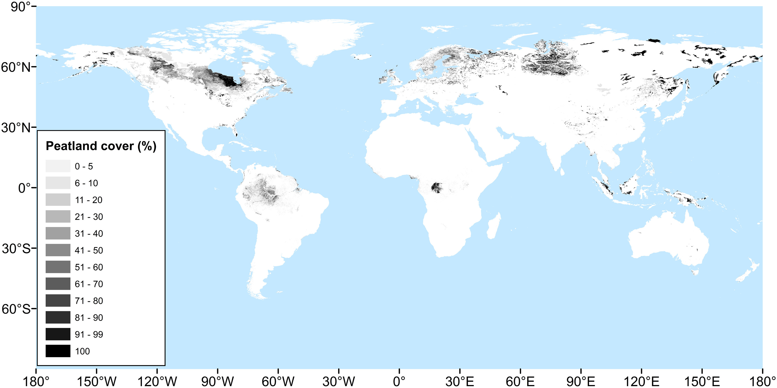
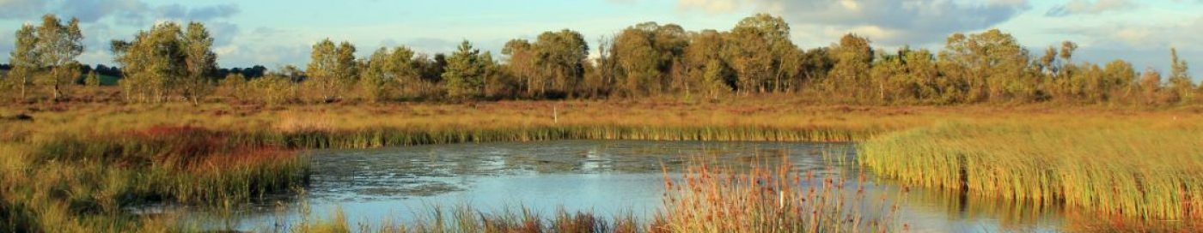
Peatland protection and restoration

Slide 23
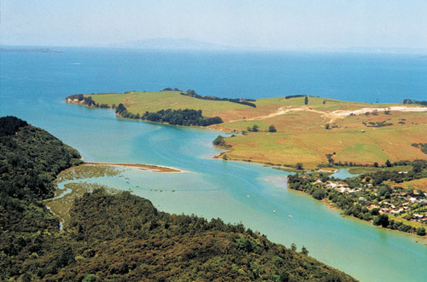
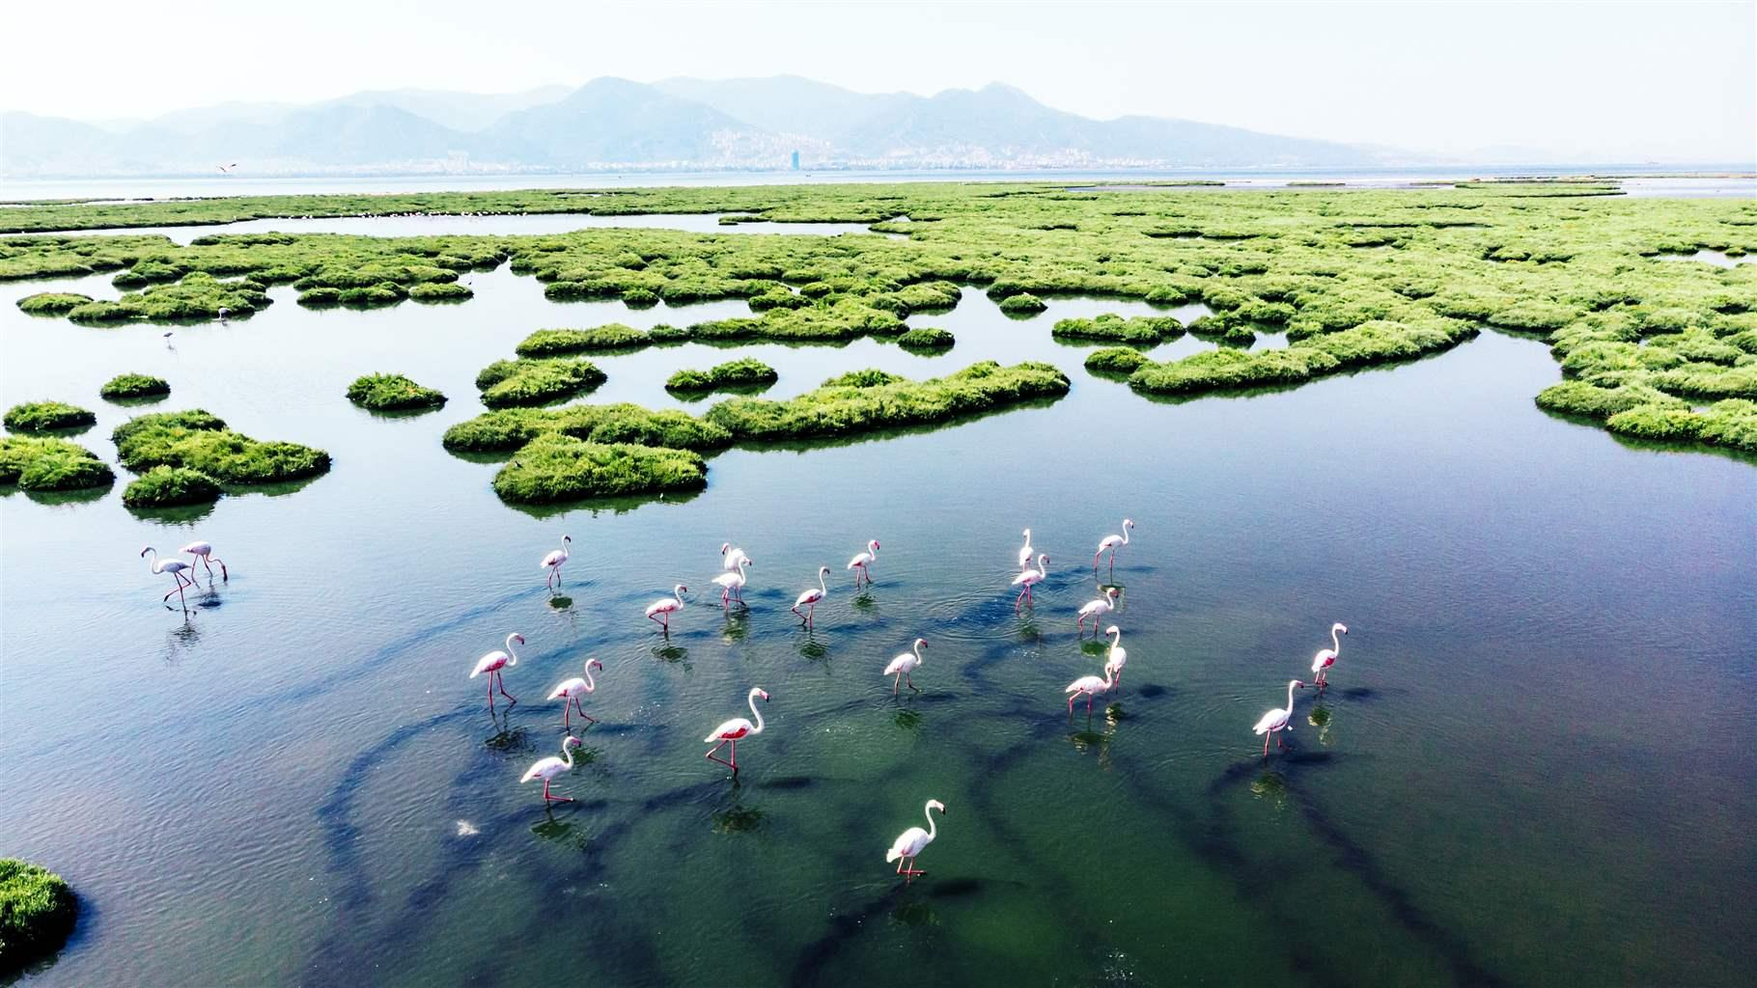
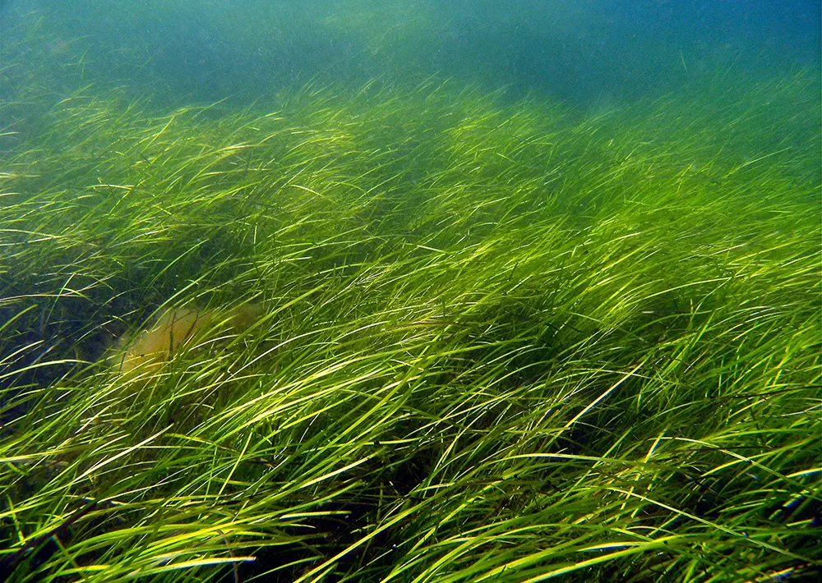
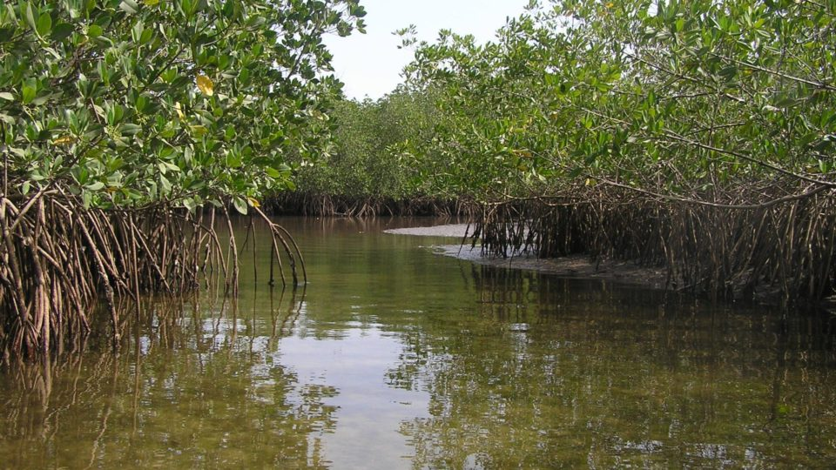
Blue carbon
Estuaries
Tidal and salt marshes
Seagrass ecosystems
Mangroves

Slide 24
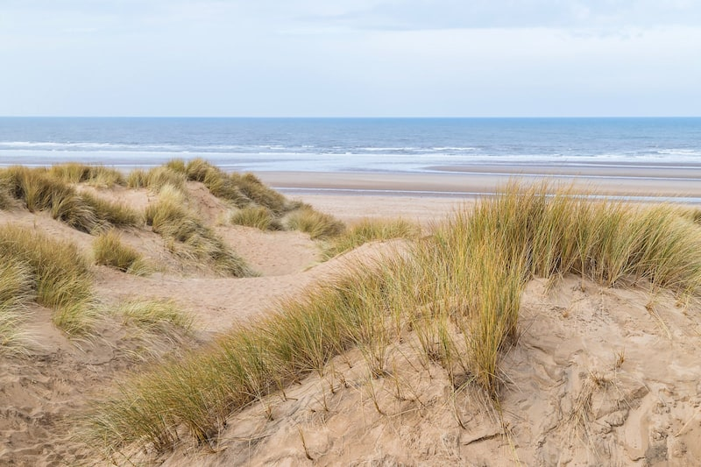
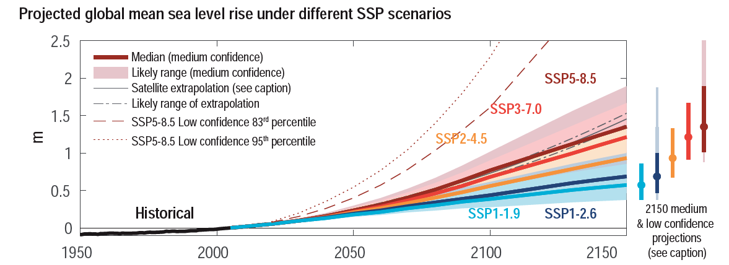
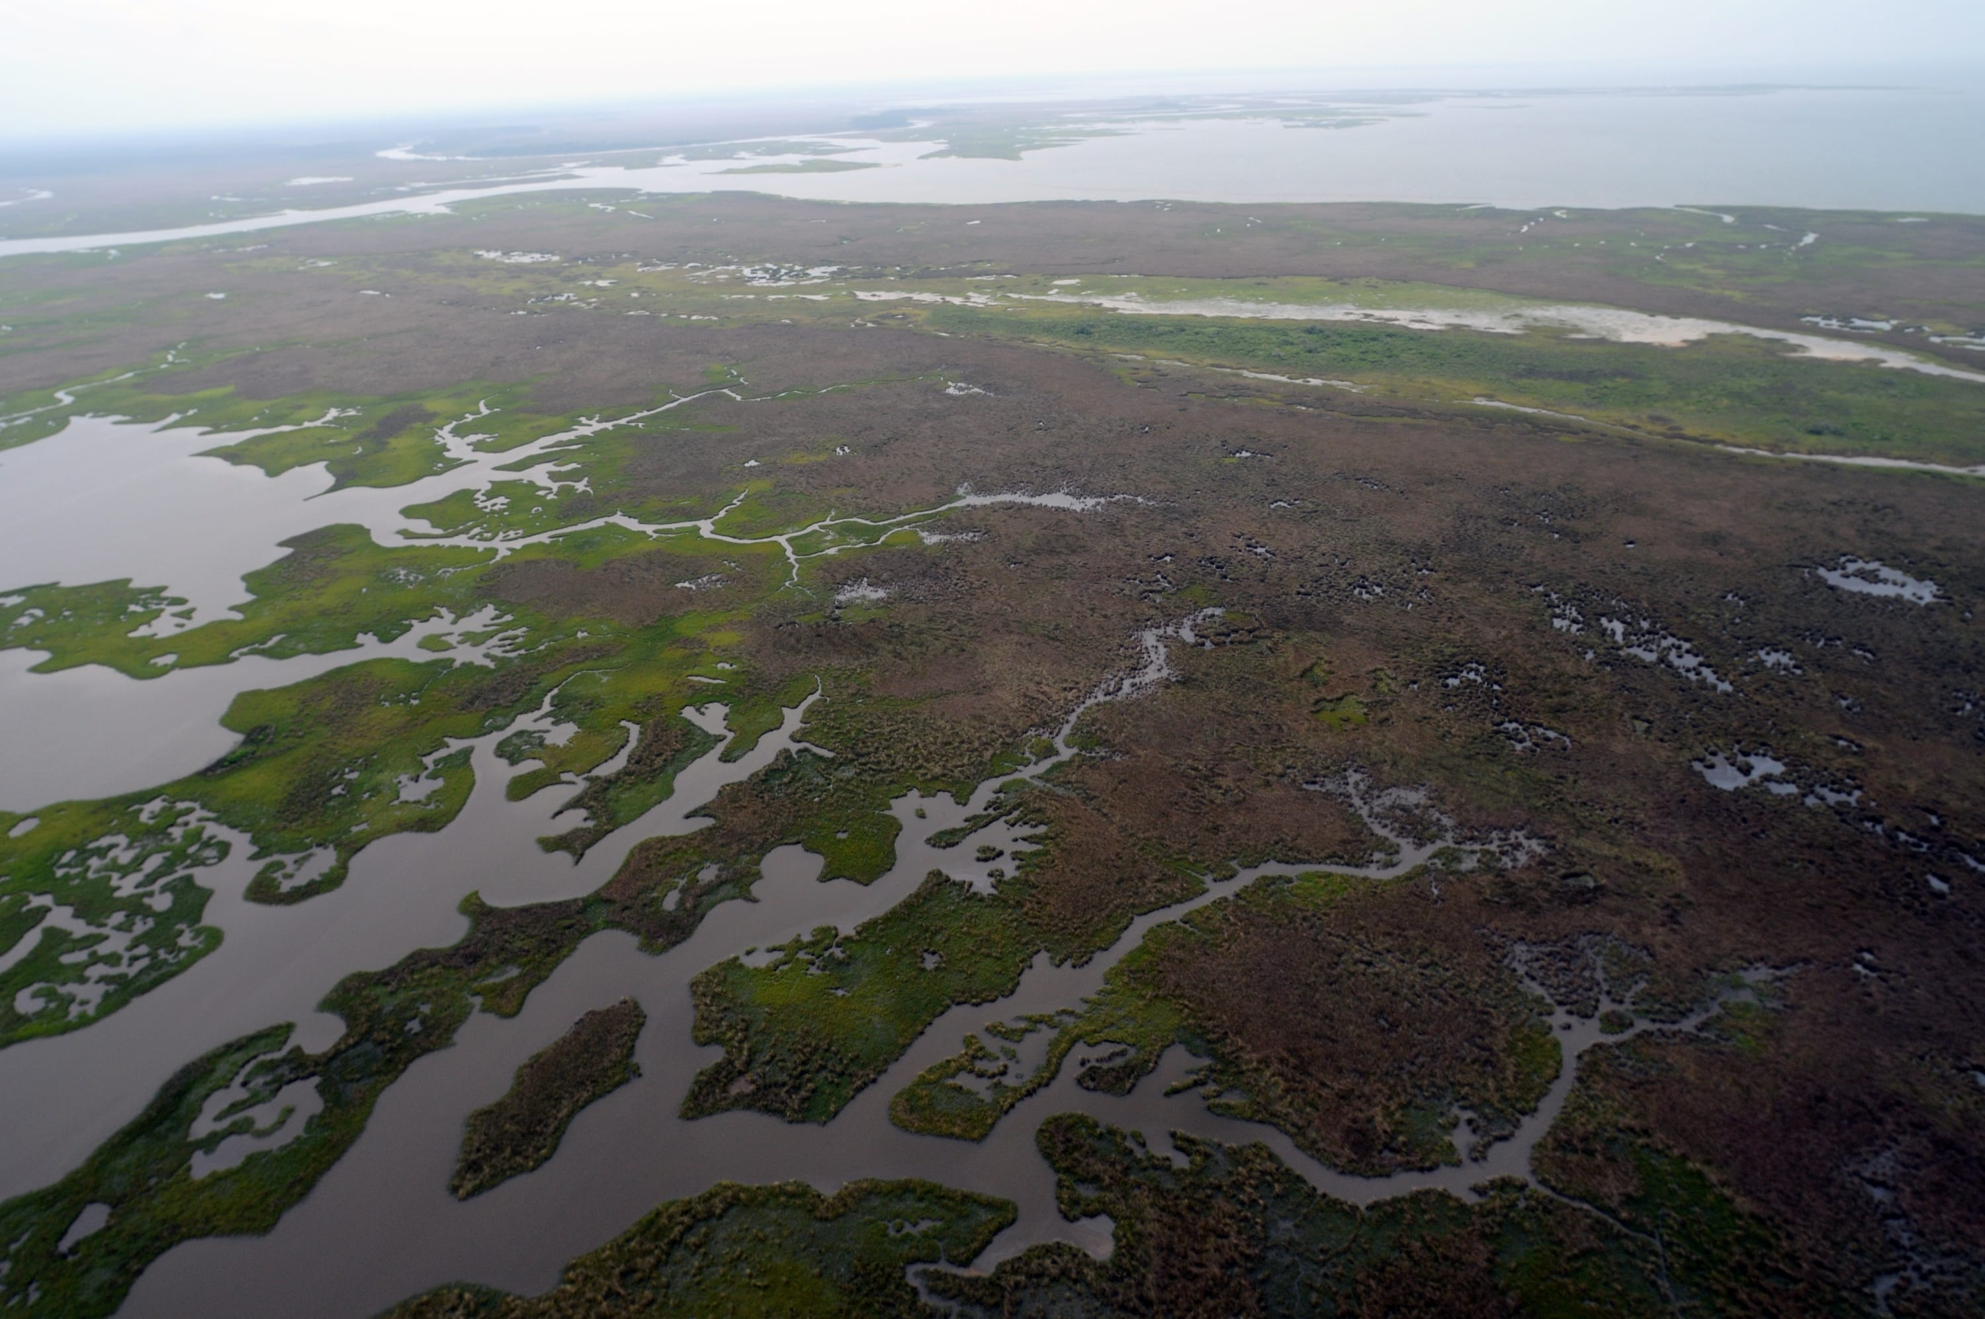
Protection – flood defences
Coastal ecosystems like sand dunes and wetlands can provide protection

Slide 25
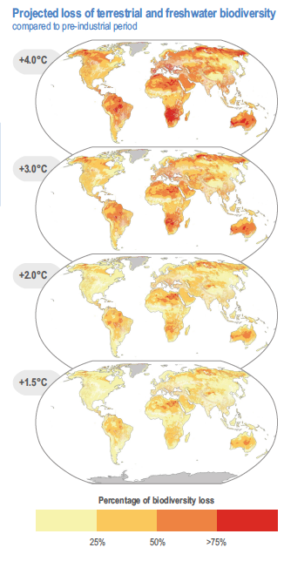
Benefits for biodiversity
Notes:
IPCC AR6, WG II, chapter 2, figure 2.6

Slide 26
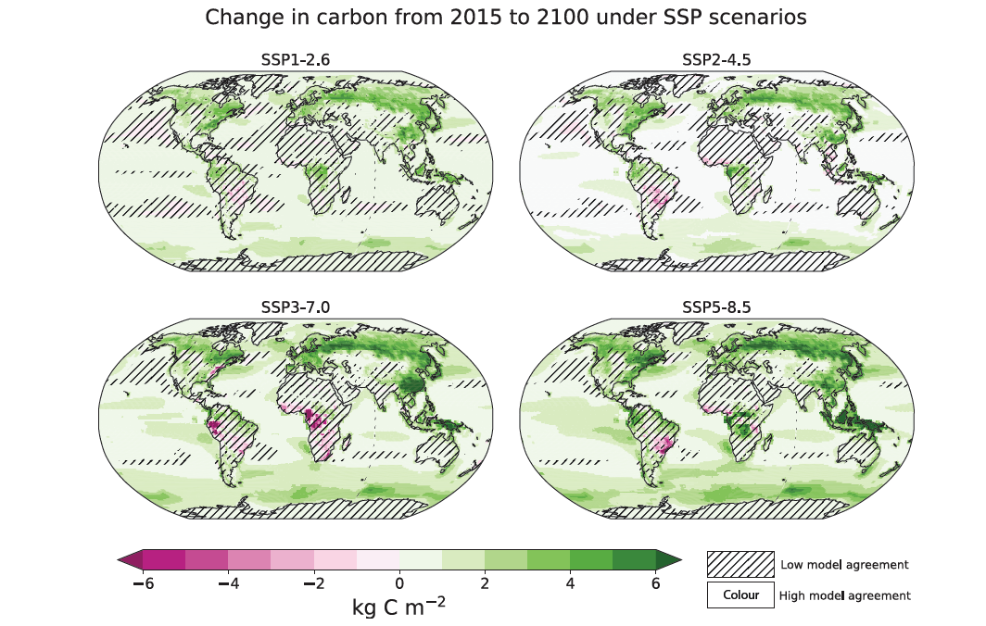
Potential increase in C stocks but also vulnerability due to extreme events
Notes:
IPCC WG I, chapter 5, figure 5.26

Slide 27
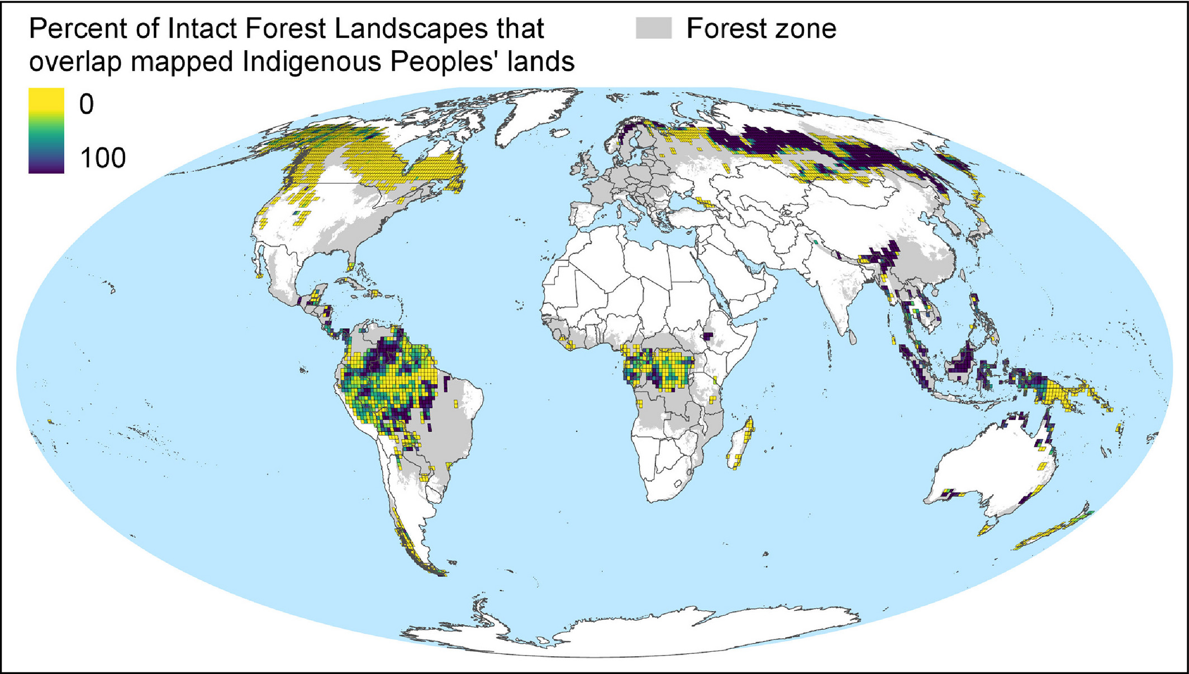
Whose land is it anyway?
Notes:
https://esajournals.onlinelibrary.wiley.com/doi/10.1002/fee.2148

Slide 28
LUC mitigation
Notes:
IPCC AR6 Synthesis Report figure SPM.7

Slide 29
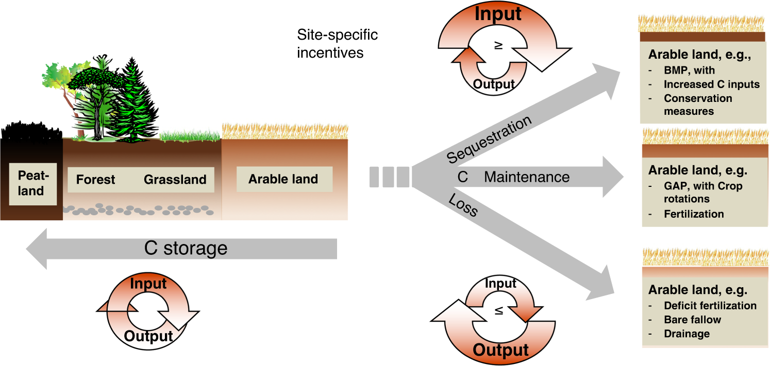
C sequestration in soils
Notes:
https://www.nature.com/articles/s41467-020-18887-7

Slide 30
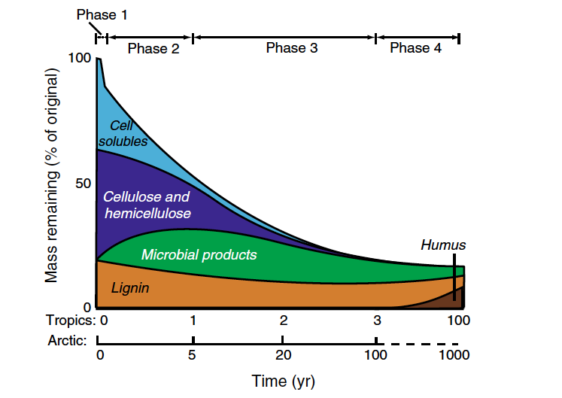
Soil organic matter storage
Soil organic matter =
plant litter input - respiration
Notes:
Lecture 7

Slide 31
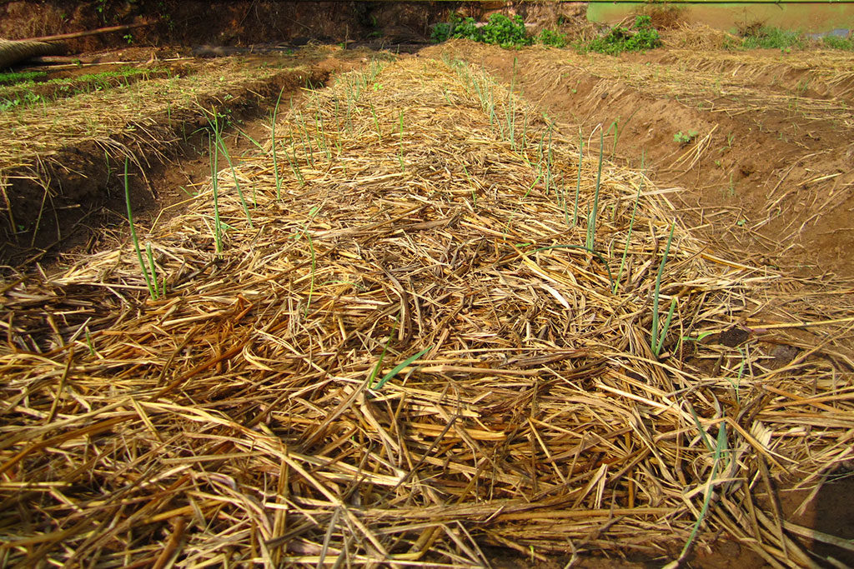
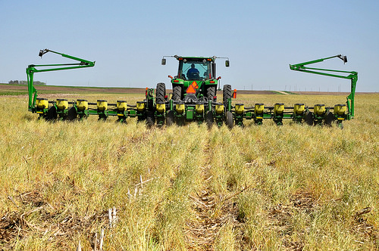
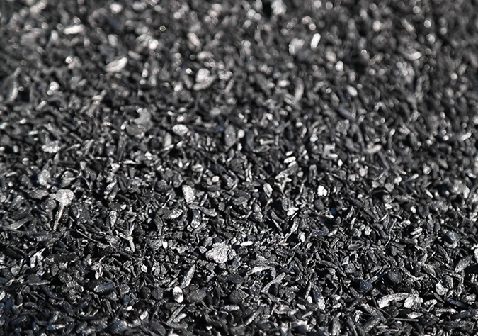
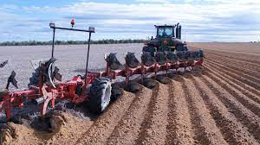
Mitigation strategies
Improve quality of organic matter input
Increase retention in soil

Slide 32
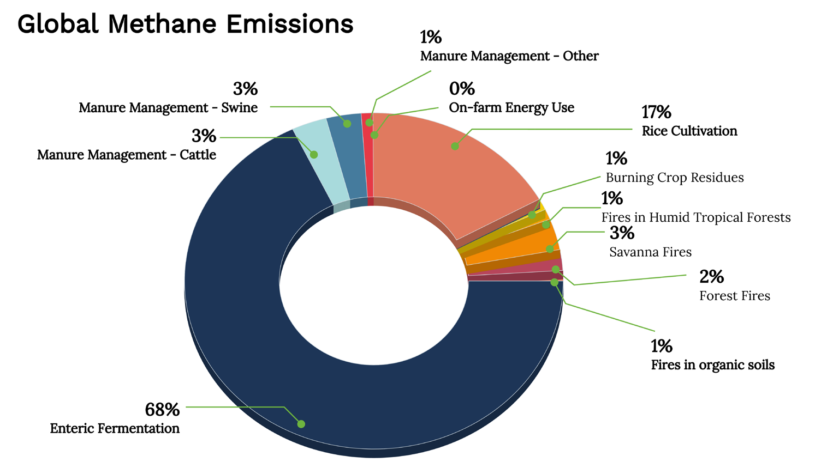
Methane emissions from agriculture
Mitigation through:
Improved animals feed
Different breeds
Management of manure storage and disposal
Notes:
https://searchinger.princeton.edu/sites/g/files/toruqf4701/files/methane_discussion_paper_nov_2021.pdf

Slide 33
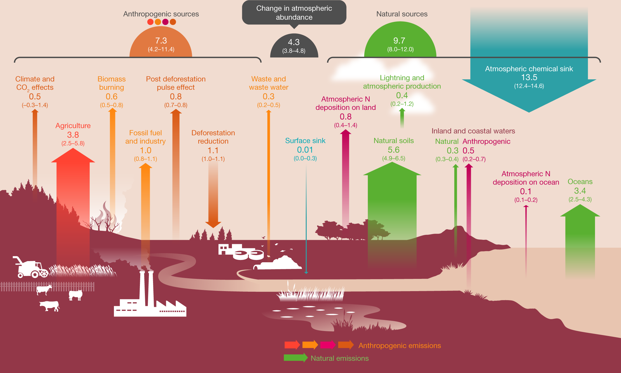
Nitrous oxide emissions from agriculture

Slide 34
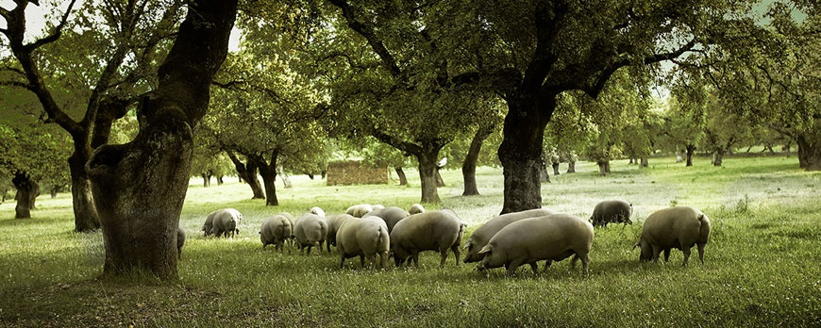
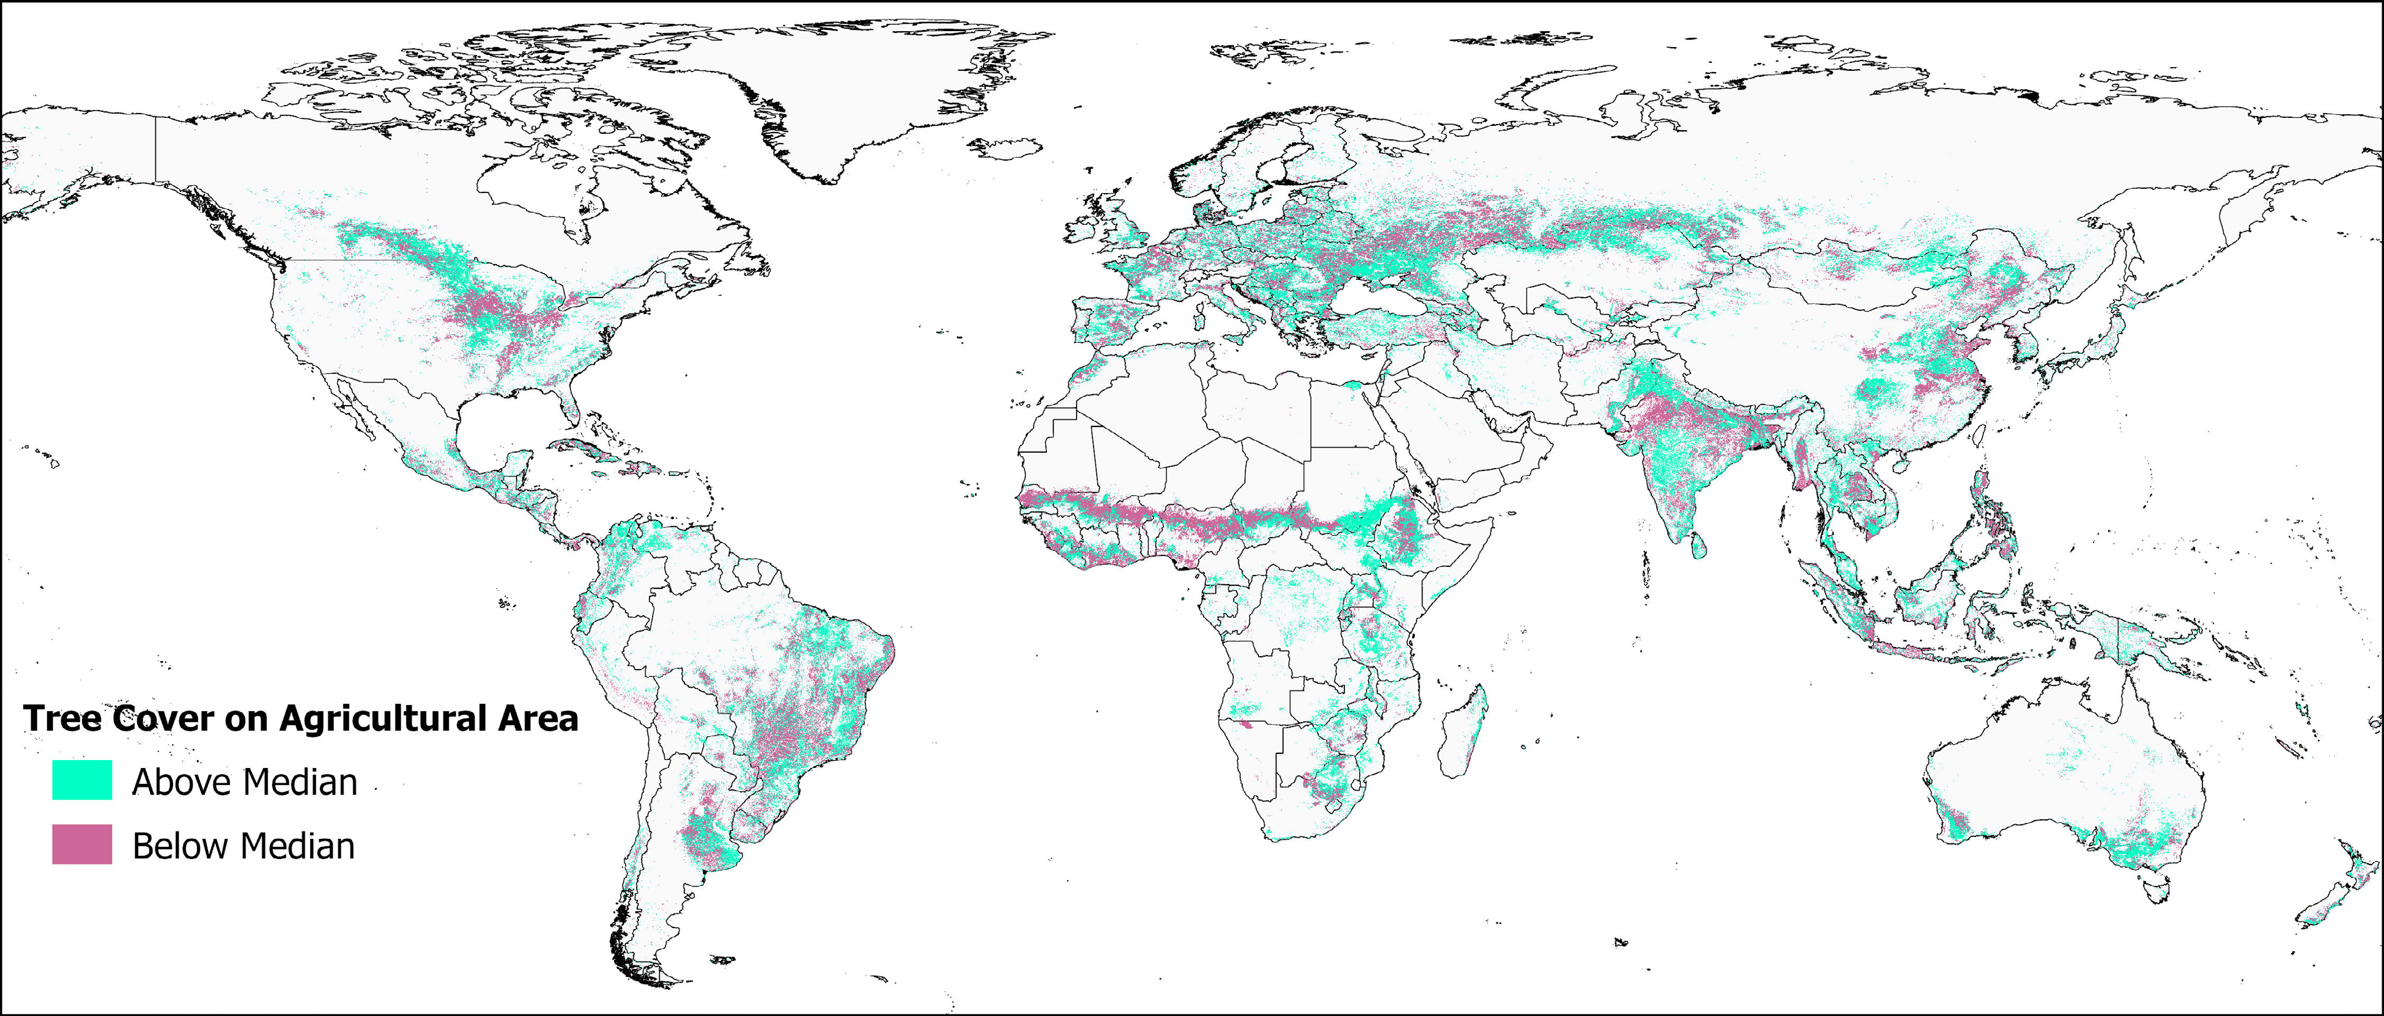
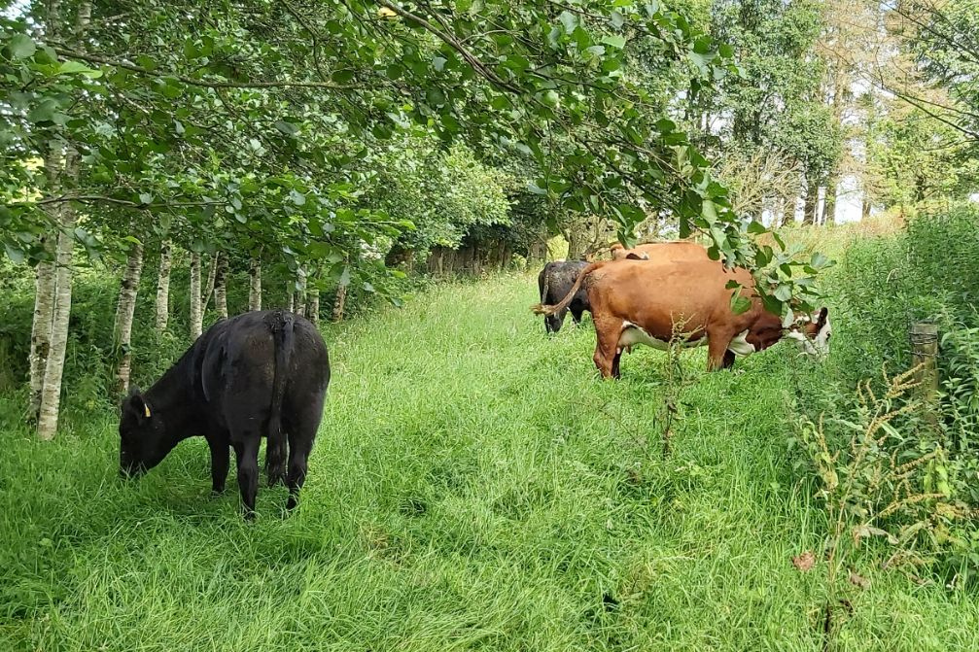
Agroforestry
Increased carbon storage in mixed systems

Slide 35
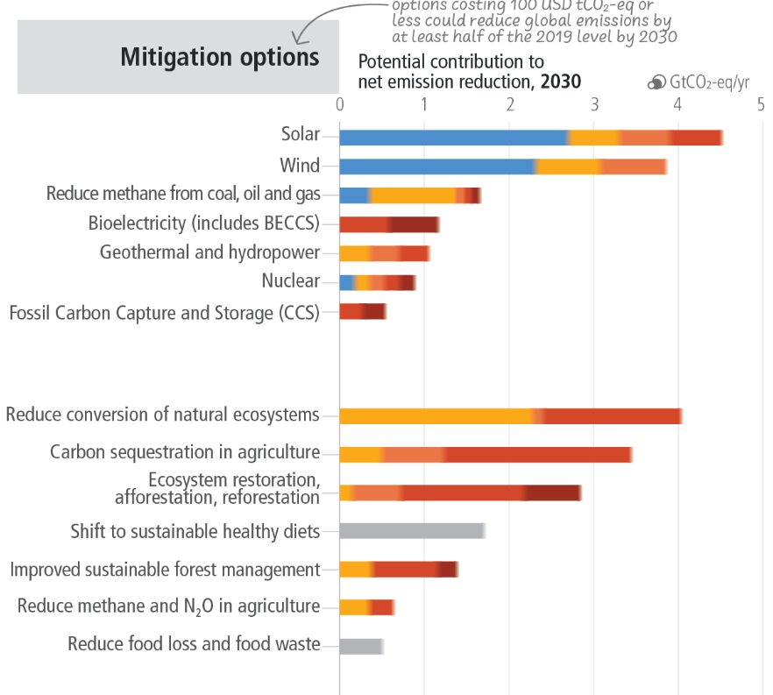
Notes:
https://www.nature.com/articles/s41467-020-18887-7

Slide 36








Atmosphere
Climate fundamentals
Predicting climate
Atmosphere
Global C cycle
IPCC report
Earth system models
Climate impacts
Climate solutions
Extreme events
Tipping points
Sea ice, ice caps
Energy
Mitigation
Nature-based solutions

